Slide 1
Genetic Programming
Lukáš Sekanina
Faculty of Information Technology
Brno University of Technology
sekanina@fit.vutbr.cz
https://www.fit.vut.cz/person/sekanina/
BISSIT, July 15, 2021

Slide 2

Genetic programing (GP)
GP is a machine learning method that can automatically design
computer programs (e.g., classifiers, predictors, neural networks, …), but also
other structures that can be represented in a computer (such as electronic circuits, molecules, antennas, artefacts …)
without requiring the user to know or specify the form or structure of the solution in advance.
GP belongs to the class of Evolutionary Algorithms that are inspired in Darwin’s theory of evolution and Neo-Darwinism.

Slide 3
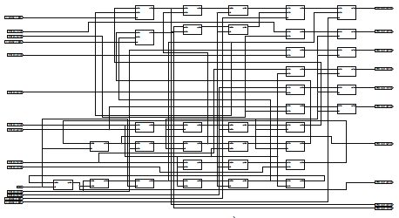

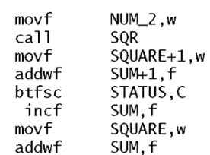
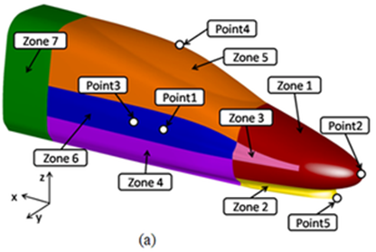
Automated design
1 Specification
2 Design system
3 Solution
Requirements
Constraints
Training data
Similar solutions
etc.
http://www.wondersofdisney.disneyfansites.com

Slide 4

Automated design
1 Specification
2 Design system
3 Solution
Requirements
Constraints
Training data
Similar solutions
etc.
Configuration
Evolutionary
algorithm
Domain simulator

Slide 5
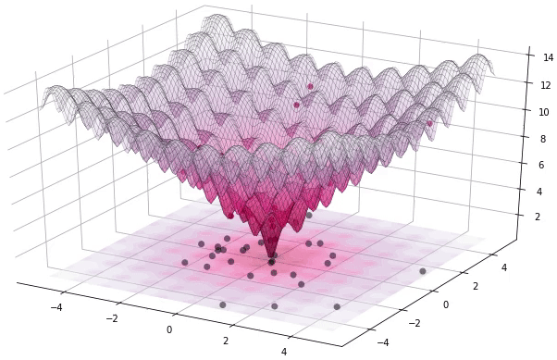
Automated design
The design problem
is transformed into
the search problem!

Slide 6


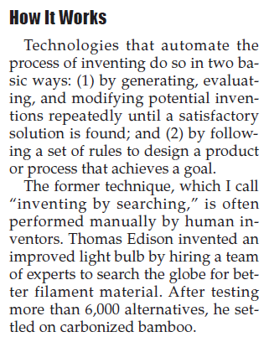

Automated design
World Future Society Special Reports 2010

Slide 7
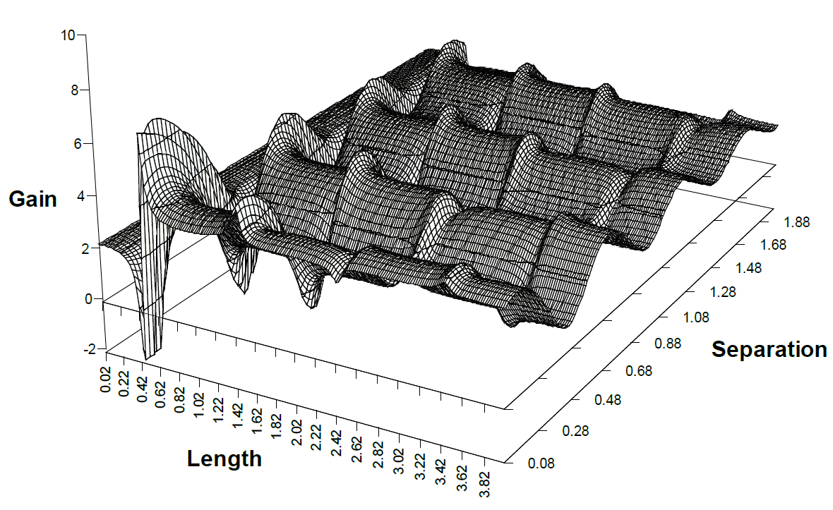
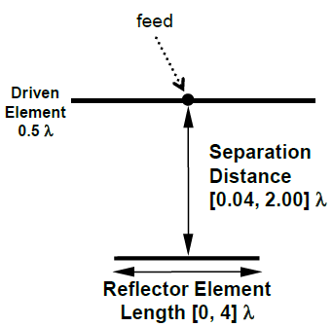
Example of the search space: a simple antenna optimization
setup
Length
Antenna
simulator
Gain
Separation
What are we
looking for?
Search space size: 2¹⁴ = 16384
The Gain is our objective (fitness) function – to be maximized.
Length: 7 bits
Separation: 7 bits
Linden, 1997
In real applications, the search space is usually much larger and multidimensional. Hence, it can not be visualized in this way!

Slide 8

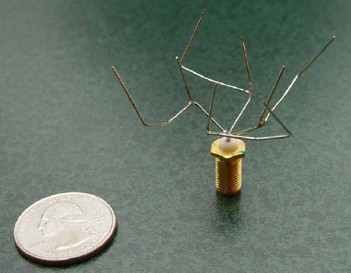

Automated design by GP
Benefits
New (unexpected) and useful designs and solutions can be obtained.
Human effort is reduced.
The design can be performed online and autonomously, in target applications such as adaptive, learning and self-repairing systems.
Problems
Scalability
Computation time (search method + simulator)
New ethical issues
NASA AMES, ST5 Mission

Slide 9
Outline
Introduction
Evolutionary algorithms
Genetic programming
Cartesian genetic programming
Applications from FIT
Summary

Slide 10
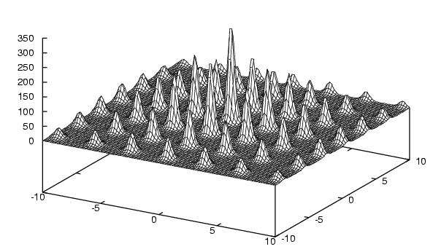
Black box optimization
Find the maximum (or minimum) of function h: R^{n} → R
Nothing is supposed about h; but we must be able to evaluate h.
Constrains can be introduced; e.g., h is not defined for some inputs.
Example for n = 2: For x ∈ <-10,10>, y ∈ <-10,10> find the maximum of h (x, y)
A randomly generated
candidate solution (24 bits):
000011000011 110011001100
Invisible in real apps!
x⁽¹⁾
y⁽¹⁾
Fitness value ~ the quality of the candidate solution:
h (x⁽¹⁾, y⁽¹⁾)
Search space size: 2²⁴
x
y
Evaluating a single point can take hours in a real optimization problem!!!
Mapping of binary numbers to real numbers <-10;10> is not discussed here.
Notes:
Random optimization (RO) is a family of numerical optimization methods that do not require the gradient of the problem to be optimized and RO can hence be used on functions that are not continuous or differentiable. Such optimization methods are also known as direct-search, derivative-free, or black-box methods.

Slide 11

Random Search vs Hill Climbing vs Evolutionary Algorithm
RS
HC
EA
Step 1
neighborhood
Step 2
neighborhood
Step 3
Highly explorative;
No info from previous steps
Exploits a small area and gets stuck at a local optimum
Population of candidate solutions;
selection and recombination.

Slide 12
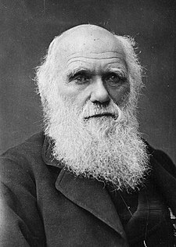

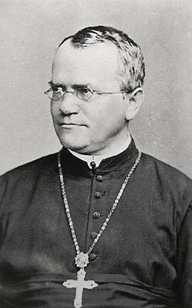
Darwinian Evolution
All species of life have descended from common ancestors.
Four Postulates
Individuals within species are variable
Some of the variations are passed on to offspring
In every generation, more offspring are produced than can survive
The survival and reproduction of individuals are not random: The individuals who survive and go on to reproduce, or who reproduce the most, are those with the most favourable variations. They are naturally selected.
On the Origin of Species by Means of Natural Selection (Darwin, 1859)
Neo-Darwinism is generally used to describe the integration of Darwin's theory of evolution by natural selection with Mendel's theory of genetics.
Charles Darwin
(1809 - 1882)
Gregor J. Mendel
(1822 - 1884)
Brno

Slide 13
Evolutionary algorithm (EA)
Evolutionary Algorithms are inspired in Darwin’s theory of evolution and Neo-Darwinism.
The term Evolutionary Algorithm covers various search algorithms that have the following common features:
There is a population (a set) of candidate solutions (= inherent parallelism).
New candidate solutions are created from previous candidate solutions using operators inspired in genetics (crossover, mutation, reproduction).
Nothing is supposed about the objective (fitness) function (the gradient is not supposed). EAs can be used on functions that are not continuous or differentiable.
EA is a stochastic algorithm; nothing is guaranteed.
EA are typically used to solve hard optimization and design problems for which common methods do not provide sufficient solutions.
Single-objective vs. multi-objective EA
Pareto dominance relation
Algorithms: NSGA-II
Dominated by α
← f₂
Pareto front
α
← f₁

Slide 14
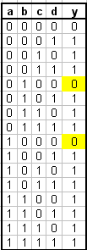
EA: From genotype to phenotype and its fitness
When can EA be used?
if it is possible to encode a candidate solution (e.g., digital circuits or NN) in a computer (e.g., as a bit string) and
if it is possible to evaluate the quality of each candidate solution using a fitness function (e.g., fitness score: 0% - 100%).
EA then performs a search in the space of possible candidate solutions using a (small) subset of candidate solutions and bio-inspired operators in order to maximize the fitness score.
genotype
00110011110010101000011000101
phenotype
a
b
y = (ab) ∨ (c ∨ d)
c
d
fitness score = 14
where the fitness function is the number of correct bits w.r.t
y(a, b, c, d) = a ∨ b ∨ c ∨ d.
(max. fitness is 16)

Slide 15
Evolutionary algorithms
Main branches:
Genetic Algorithms – GA (Holland ~1973)
Evolution Strategies – ES (Rechenberg and Schwefel ~1964)
Evolutionary Programming - EP (Fogel ~1962)
Genetic Programming – GP (Cramer ~1985, Schmidhuber ~1987, Koza, ~1989)
and others such as differential evolution, grammatical evolution, …

Slide 16



The main loop of EA
Selection of parents
Evaluation
Create the initial population
fitness
chromosomes
Recombination (crossover)
Replacement
Mutation
Problem encoding: string of integers

Slide 17
The main loop of EA
Generate the initial population (randomly or heuristically)
Evaluate each candidate solution using the fitness function
WHILE termination_condition_is_not_satisfied DO
Create new population
Select parents (according to the fitness)
Create offspring individuals from parents using crossover, mutation …
Create a new population by replacing some/all parents by offspring individuals.
Evaluate the population
Notes:
The candidate solution with the highest fitness score is the result of EA. A single-objective optimization is assumed. In the multi-objective optimization, we simultaneously optimize more objectives (e.g., performance and cost) and the result is not one solution, but a set of Pareto solutions.

Slide 18
Terminology in EA (inspired in biology)
Genotype (chromosome, DNA)
representation of a candidate solution in the computer
consists of genes
can have a variable size
Gene
a basic element of the genotype
its value (allele) belongs to a given alphabet
Phenotype
a candidate solution
is created on the basis of the genotype content
Population
consists of candidate solutions
its size is typically constant
Generation
is one iteration of EA
Genetic operators (mutation, crossover, selection, …)
create new genotypes from existing genotypes
Fitness function
assigns the fitness value (score) to a phenotype

Slide 19
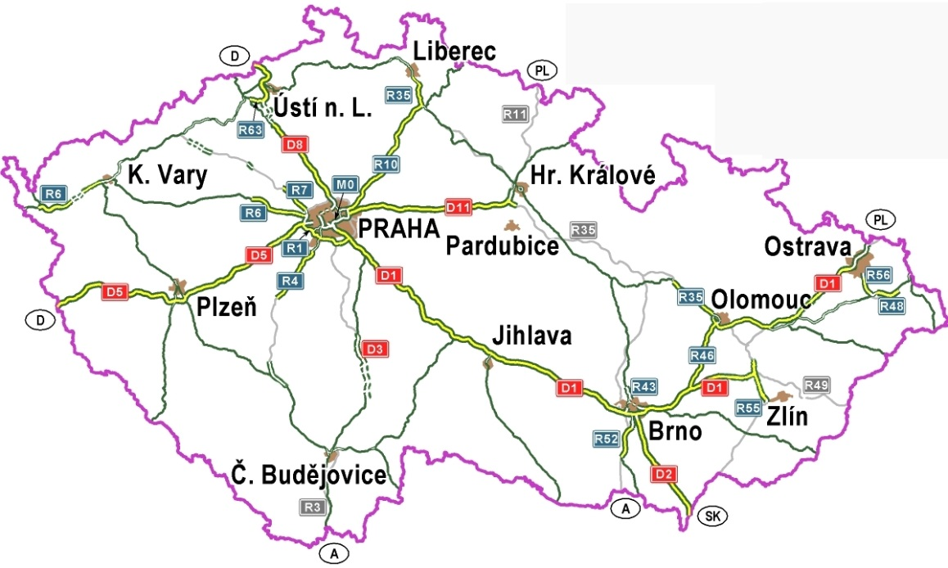

Problem encoding
Examples of candidate solutions containing 2 genes:
Binary: 000011;010011
Int: 3;-19
Float: 3e0;19e2
The most common encodings:
vector of integers, binary and/or real numbers
permutation – see the example
specific genetic operators have to be developed
used for solving the travelling salesman problem (TSP)
syntax tree – in GP
acyclic directed graph – in CGP
Example: Permutation encoding for TSP
1 – Praha
2 – Brno
3 – Ostrava
4 – České Budějovice
5 – Olomouc
6 – Plzeň
7 – Liberec
8 – Jihlava
9 – Zlín
10 – Pardubice
7
Encoded route
10
1
3
6
8
5
9
2
7
10
3
9
5
2
8
4
6
1
4
mutation
7
10
3
5
9
5
9
2
8
4
6
1

Slide 20
Genetic operators – crossover over binary vectors
Parents
Offspring
Chromosome 1:
1 0 0 1 1 | 0 0 1
1 0 0 1 1 1 0 1
➔
Chromosome 2:
0 1 1 0 1 | 1 0 1
0 1 1 0 1 0 0 1
a) Single point
Chromosome 1:
1 0 0 | 1 1 | 0 0 1
1 0 0 0 1 0 0 1
➔
Chromosome 2:
0 1 1 | 0 1 | 1 0 1
0 1 1 1 1 1 0 1
b) Double point
Chromosome 1:
1 0 0 1 1 0 0 1
1 1 1 1 1 0 0 1
➔
Chromosome 2:
0 1 1 0 1 1 0 1
0 1 1 1 1 1 0 1
c) Uniform – every bit considered separately
In GAs, the probability of crossover is usually ~0.7.

Slide 21
Genetic operators – mutation
Mutation is a very small change in a single chromosome – e.g., a bit inversion.
Chromosome:
1 0 0 1 1 0 0 1 0 1 1 0 0 1
After mutation:
1 0 0 0 1 0 0 1 0 1 1 0 1 1
In GAs, the probability of mutation is usually < 0.05.

Slide 22
Selection of parents
Solutions with a higher fitness have higher probability to be selected.
Major methods:
Roulette wheel selection (fitness proportional) – a relative fitness is calculated for every individual: f_{r}(i) = f(i) / Σ f(i), i = 1 … pop_size
Individuals are selected proportionally to f_{r}.
Problem: If there is an individual with very high f_{r} and remaining ones have very low f_{r}, the best one will be selected all the time ⇒ degeneration of the population
Rank selection – similar to the roulette wheel selection, but candidate solutions are sorted according to the fitness first and the selection is based on the rank (not on the absolute fitness values).
Tournament selection – randomly chooses K individuals from the population and selects one with the best fitness score.
The selection procedure is repeated until the required number of parent individuals is not obtained.
An individual can be selected multiple times.
It is not guaranteed that the current best-scored individual will be selected.

Slide 23
Roulette wheel selection (example)
Calculated portions for the individuals
Populations & fitness:
The number of portions
1
1
0
0
-> fitness (12) = 6
1
1
0
0
1
0
0
0
-> fitness (8) = 4
1
0
0
0
6 + 4 + 4 + 2 = 16
0
1
0
1
-> fitness (5) = 4
0
1
0
1
0
0
1
1
-> fitness (3) = 2
0
0
1
1
Resulting parents:
1
1
0
0
1
1
0
0
0
1
0
1
1
0
0
0
In order to obtain 4 individuals, the roulette is run 4 times.
very unlikely
typical result

Slide 24
Replacement and termination criteria
Replacement mechanisms
Steady-state EA: The new population of P individuals will contain N individuals from the old population and M new offspring individuals (P = N + M).
Generational EA: The new population contains only new offspring individuals.
Elitism – the best e individuals of the previous population are automatically copied to the new population (e is usually 1).
Typical termination criteria
A solution with fitness = 100% was discovered.
The available time or the number of generations was exhausted.
There has not been any progress in the fitness score in the last k generations.

Slide 25
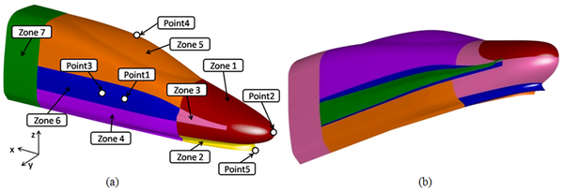
Examples
Small examples
Genetic Algorithm for Solving the Multiple Traveling Salesman Problem
https://www.youtube.com/watch?v=Kt7J1Kbwco8
Differential Evolution Optimization of an Airfoil
https://www.youtube.com/watch?v=vzcrW6xZAtI
Evolving a robot kick with evolutionary algorithms
https://www.youtube.com/watch?v=SZ4gNgP_Bmw
Real-world applications: High-speed Train optimization
Xu G, Liang X, Yao S, Chen D, Li Z (2017) Multi-Objective Aerodynamic Optimization of the Streamlined Shape of High-Speed Trains Based on the Kriging Model. PLOS ONE 12(1)

Slide 26
In order to use EA one has to:
develop
problem encoding
genetic operators
fitness function
set up the EA parameters
population size
initialization of the population
number of generations
probability of mutation, crossover …
the termination condition
statistically evaluate the results (EA is a stochastic algorithm!)
repeat the EA run several times
report the best / average / median results
repeat the entire process if EA does not work
In case of real-world applications, there is no relevant theory for solving these issues!

Slide 27
Evaluation of EAs: Is EA₁ better than EA₂?
Time of evolution ≈ G * (P*T_{a} + T_{p})
G is the number of generations
P is the population size
T_{a} – the evaluation time of a single candidate solution
T_{p} – the time to create a new population (crossover/mutation/selection)
The number of fitness evaluations G*P is usually considered.
A single run is not important (lucky chance)!
r runs have to be performed to get statistically relevant results. The quality of EA is measured using:
The average (median) number of evaluations to find a solution (out of r runs).
The number of successful runs out of r runs.
Many other methods exists.
If we are not satisfied with a given EA, some EA’s parameters or mechanisms should be changed.
Then, the complete statistical evaluation has to be performed again.
Experience: r ≥ 30 to get statistically relevant results.

Slide 28
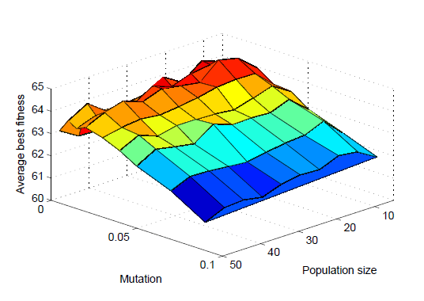
Ex.1: What is the most suitable population size and mutation probability?
The best setting:
pMutt = 0.02
popSize = 15
Principles of the statistical evaluation - an example:
Except the population size (10 options for P), the number of generations (G=40000/P), and the mutation probability (10 options) all other EA parameters remain unchanged! The number of evaluations P*G = 40000 is fixed to ensure the same execution time for each run.
50 independent runs for each combination of parameters are performed.
In total, 50 x 10 x 10 independent runs are performed.
The average best fitness out of 50 independent runs is reported.

Slide 29
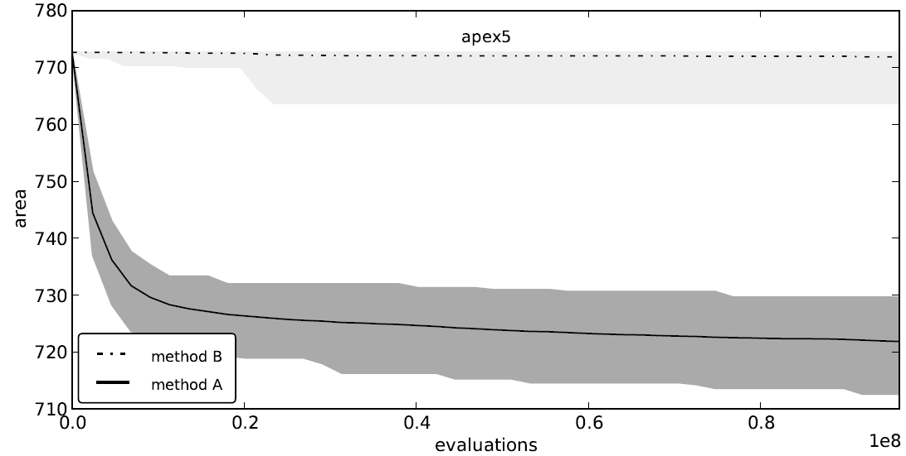
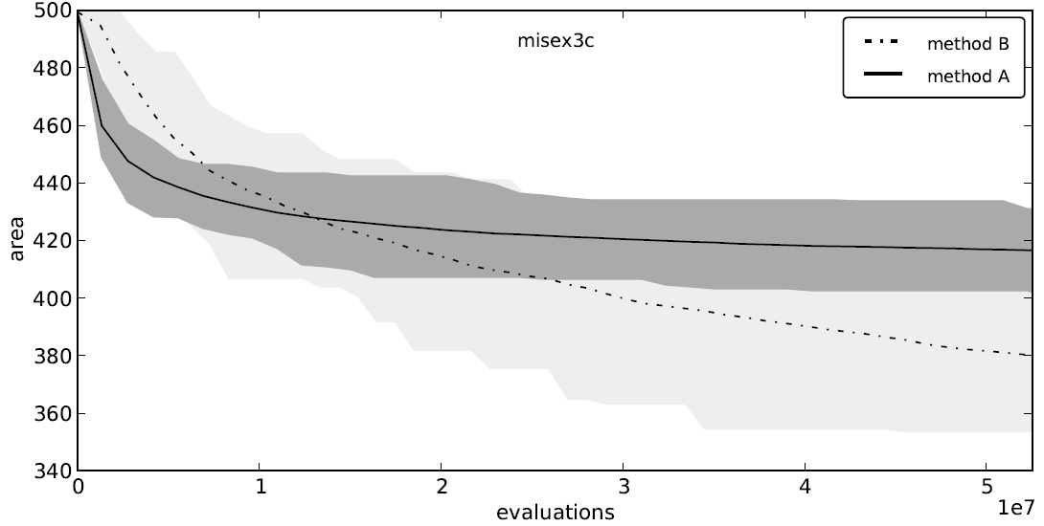
Ex. 2: Comparison of EA-A and EA-B in the circuit area optimization (minimization)
EA-B does not work
Maximum, minimum and average out of 50 runs shown during the progress of optimization.
EA-A – almost ideal runs!
EA-A is better at the beginning of the optimization.

Slide 30
Outline
Introduction
Evolutionary algorithms
Genetic programming
Cartesian genetic programming
Applications from FIT
Summary

Slide 31
GP: Principles
The goal of GA is to find (close to) optimal values of a vector of parameters.
The goal of GP is to find a program (close to) optimally working for arbitrary input data.
In GP
the search algorithm is almost identical with GA.
candidate programs are represented using syntax trees (or other suitable graphs), machine code instructions or strings of integers
in addition to crossover and mutation, more complex genetic operators can be used, e.g., subprogram definition
in order to obtain the fitness score, a candidate program is executed using the training data
the result of GP (i.e., the best-performing program) is evaluated using the test data.

Slide 32
GP Flowchart
Gen – the number of generations
N – the number of runs of GP
M – the population size
P_{r} – probability of reproduction
P_{c} – probability of crossover
P_{m} – probability of mutation

Slide 33
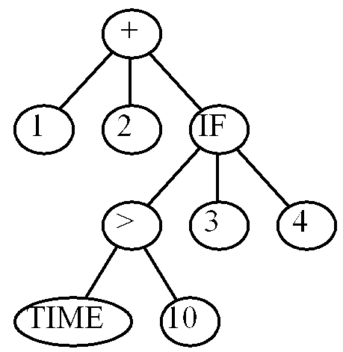
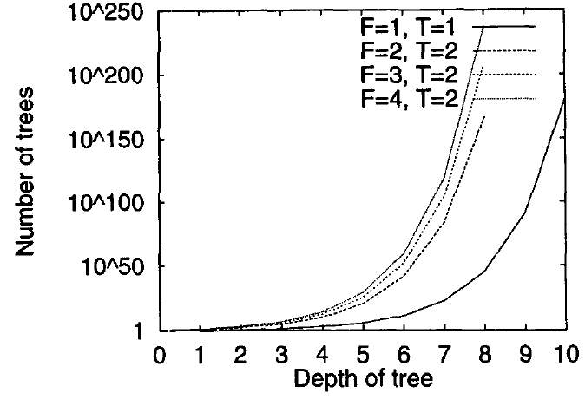
GP: Program representation using a syntax tree
Set of terminals (T)
inputs
constants
functions with 0-arity
Set of functions (F)
Standard math. functions
Application-specific functions (e.g. GetSensorValue(i))
Protected versions of some functions are used (to enable the evaluation for all inputs, e.g. division is extended for 0; e.g. x / 0 = 1)
Syntax tree
LISP expression
(+ 1 2 (IF (> TIME 10) 3 4))
Author: Mark Ebner, 1999
Program code
IF TIME > 10 THEN E = 3 ELSE E = 4
Output = 1 + 2 + E

Slide 34
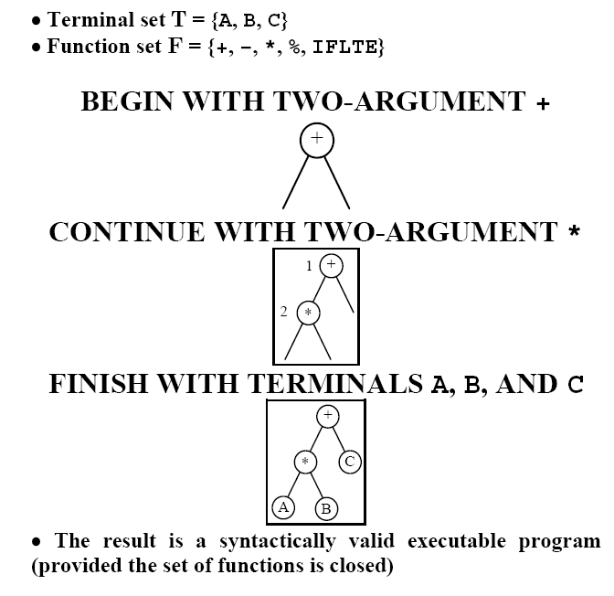
GP: Random program generation
Random population generation
Max tree depth = h
Methods
Grow – randomly choose items from T or F
Full – randomly choose items from F until h is not reached, then use T.
Ramped Half-and-Half – for each depth 1 .. h generate half individuals with Grow and half individuals with Full method.

Slide 35
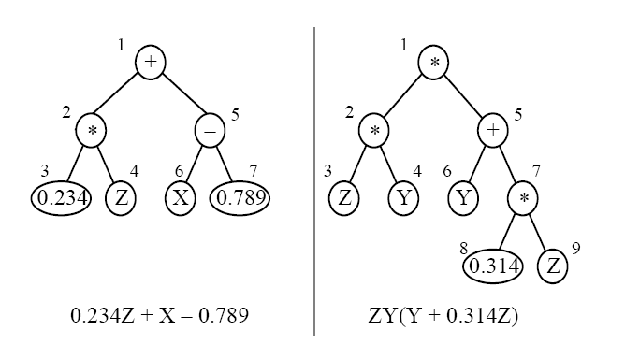
GP: Crossover
2 parents
Crossover swaps randomly selected sub-trees.
2 offspring

Slide 36
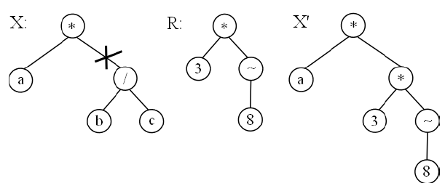
GP: Mutation
Randomly select a node (a corresponding sub-tree is marked) in X and replace the sub-tree by a randomly generated sub-tree R to get X’.

Slide 37
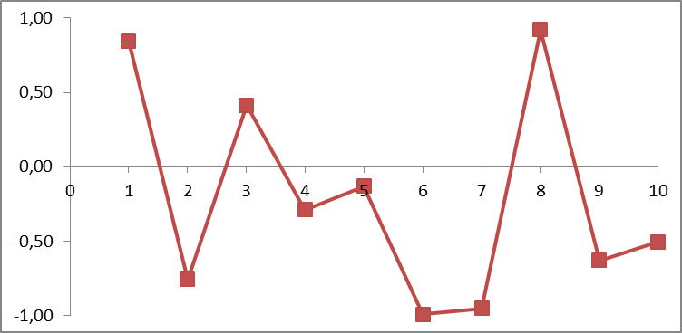
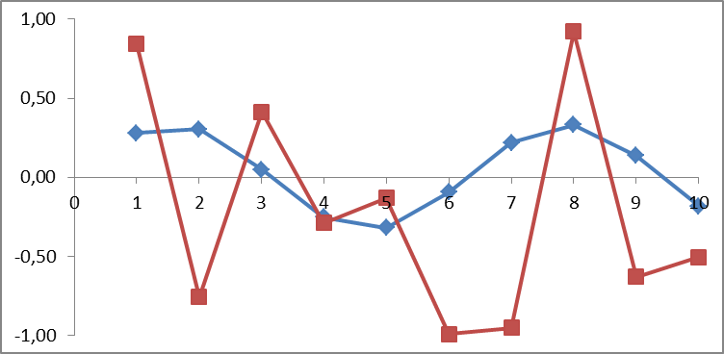
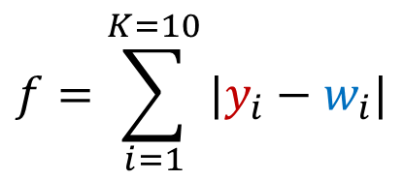
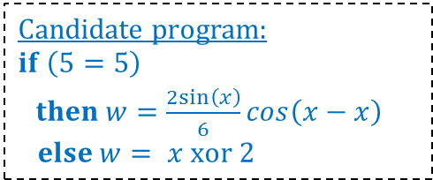
Symbolic regression (~ data fitting)
Test cases
The number of test cases
x | y
1 | 0,84
2 | -0,76
3 | 0,41
4 | -0,29
5 | -0,13
6 | -0,99
7 | -0,95
8 | 0,92
9 | -0,63
10 | -0,51
$$f=\sum_{i=1}^{K=10}{|y_{i}}−w_{i}|$$
= 5.96
Program’s response
Desired response
Candidate program:
$$if \left(5=5\right)$$
$then w=\frac{2sin\left(x\right)}{6}cos\left(x−x\right)$
$$else w= x xor 2$$
Why with GP?
An arbitrary function set can be used (no assumptions in terms of mathematical properties).
Can optimize many objectives together (error, size, speed …).
Can be extended to n-input / m-output problems.
Constraints can easily be handled.
Disadvantages: computationally expensive, stochastic

Slide 38
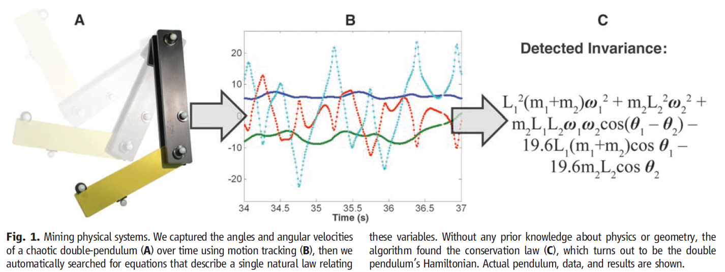
Symbolic regression
Eureqa www.nutonian.com
M Schmidt, H Lipson.: Distilling free-form natural laws from experimental data. Science, 2009
Since 2009 this technology is now used by more than 40,000 users including many Fortune-500 companies.

Slide 39
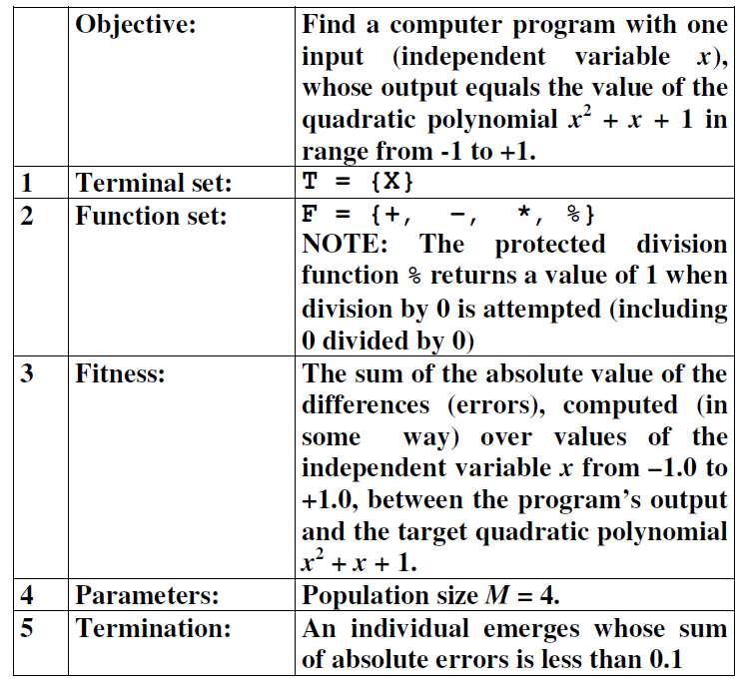
Symbolic regression – Example 1
Independent variable X | Dependent variable Y
-1.00 | 1.00
-0.80 | 0.84
-0.60 | 0.76
-0.40 | 0.76
-0.20 | 0.84
0.00 | 1.00
0.20 | 1.24
0.40 | 1.56
0.60 | 1.96
0.80 | 2.44
1.00 | 3.00

Slide 40
Symbolic regression – Example 1
GENERATION 0

Slide 41
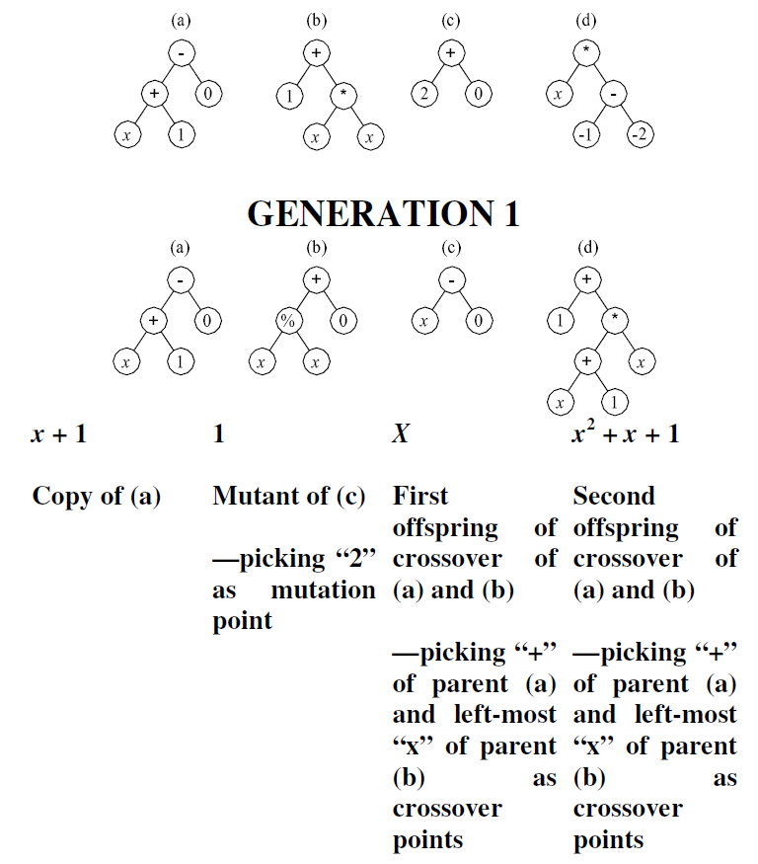
Symbolic regression – Example 1
GENERATION 0

Slide 42
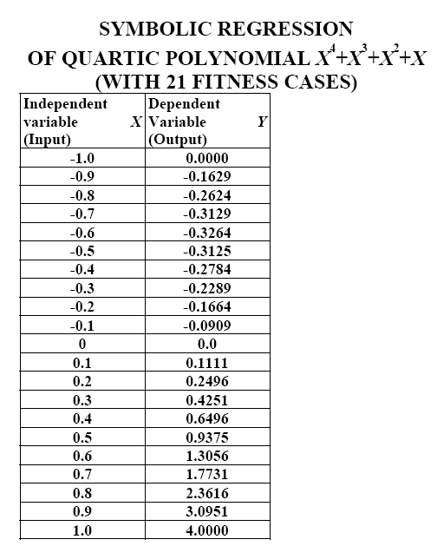
Symbolic regression – Example 2

Slide 43
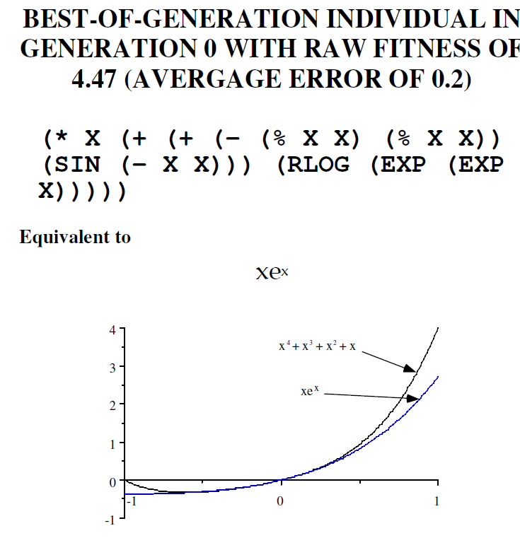
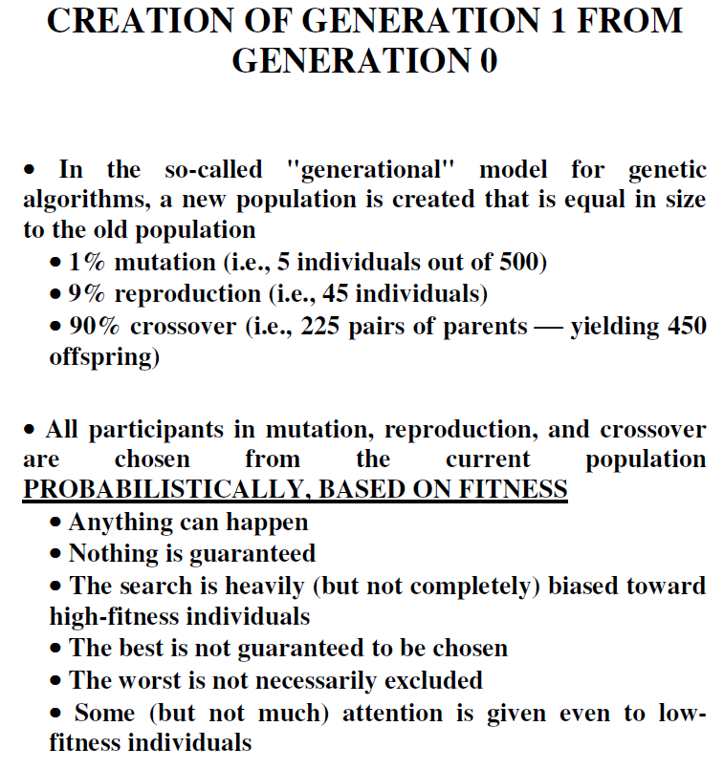
Symbolic regression – Example 2

Slide 44
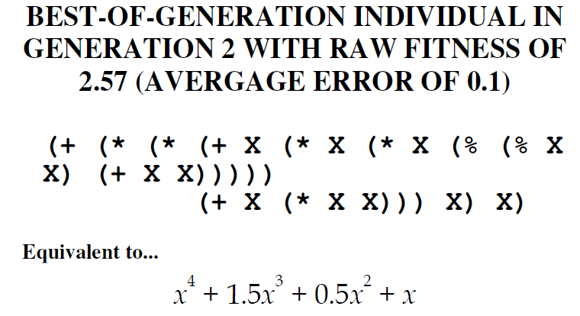
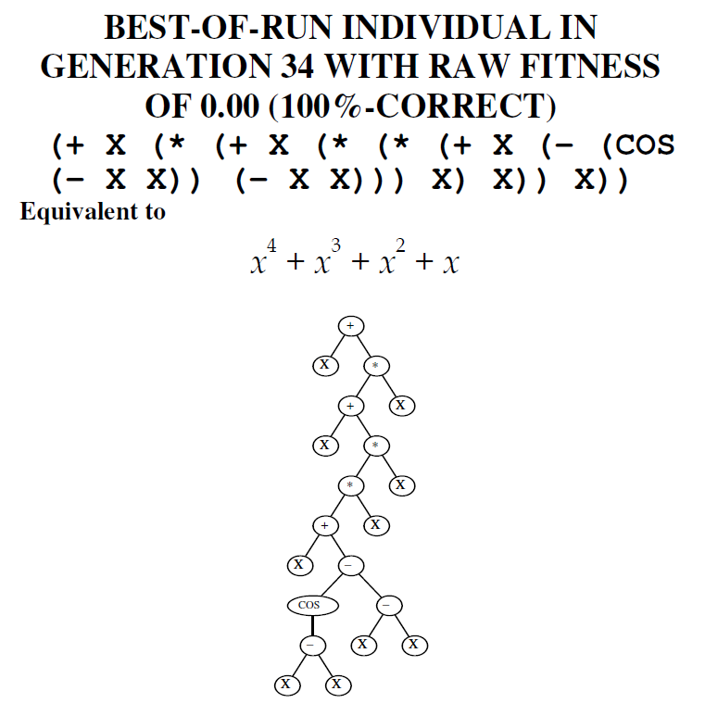
Symbolic regression – Example 2
COS (X – X), (X – X) etc. are examples of the so-called intron – a piece of code which does not contribute to the fitness, but increases the size of candidate solution. Note that COS (X – X) can be replaced by 1 etc.
Bloat – a phenomenon in which the program size grows during the evolution, but the fitness remains unchanged. Various techniques were developed to eliminate the bloat.

Slide 45
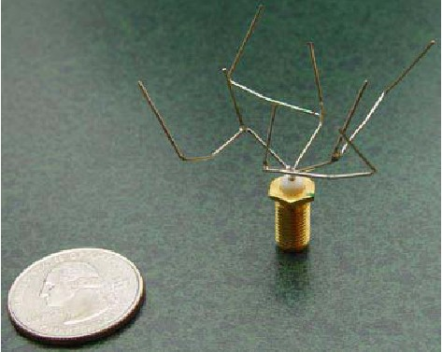

Applications of GP
Predictors, classifiers, schedulers, controllers, etc.
Not as scalable as DNNs, but the resulting solution can be optimized for error as well as the size and other criteria
Their behavior can often be explained.
Game strategies
Design of DNNs, circuits, regulators, antennas, quantum circuits, antennas, …
Automated design of program tests
Automated software repair
Genetic improvement of software
Automated patent invention

Slide 46

Humies competition at GECCO conferences
Human-Competitive Results Produced By Genetic And Evolutionary Computation
http://www.human-competitive.org/

Slide 47
Humies competition
J. Koza: We say that an automatically created result is “human-competitive” if it satisfies one or more of the eight criteria below.
(A) The result was patented as an invention in the past, is an improvement over a patented invention, or would qualify today as a patentable new invention.
(B) The result is equal to or better than a result that was accepted as a new scientific result at the time when it was published in a peer-reviewed scientific journal.
(C) The result is equal to or better than a result that was placed into a database or archive of results maintained by an internationally recognized panel of scientific experts.
(D) The result is publishable in its own right as a new scientific result ¾ independent of the fact that the result was mechanically created.
(E) The result is equal to or better than the most recent human-created solution to a long-standing problem for which there has been a succession of increasingly better human-created solutions.
(F) The result is equal to or better than a result that was considered an achievement in its field at the time it was first discovered.
(G) The result solves a problem of indisputable difficulty in its field.
(H) The result holds its own or wins a regulated competition involving human contestants (in the form of either live human players or human-written computer programs).

Slide 48
Humies winners
Year | Humies Winners | Institution
2004 | An Evolved Antenna for Deployment on NASA's ST 5 Mission | NASA AMES, US
 | Automatic Quantum Computer Programming: A GP Approach | Hampshire Coll., US
2005 | Two-dimensional photonic crystals designed by evolutionary algorithms | Cornell U., US
 | Shaped-pulse optimization of coherent soft-x-rays | Colorado S. Univ., US
2006 | Catalogue of Variable Freq. and Single-Resistance-Controlled Oscillators | MIT, US
2007 | Evol. Design of Single-Mode Microstructured Polymer Optical Fibers | UCL, UK
2008 | Genetic Programming for Finite Algebras | Hampshire Coll., US
2009 | A Genetic Programming Approach to Automated Software Repair | U. of New Mexico, US
2010 | Evol. design of the energy function for protein structure prediction | U. of Nottingham, UK
2011 | GA-FreeCell: Evolving Solvers for the Game of FreeCell | Ben-Gurion U., IL
2012 | Evolutionary Game Design | ICL, UK
2013 | Evolutionary Design of FreeCell Solvers | Ben-Gurion U., IL
 | Search for a grand tour of the Jupiter Galilean moons | ESA, EU
2014 | Genetic Algorithms for Evolving Computer Chess Programs | Bar-Ilan University, IL
2015 | Evolutionary Approach to Approximate Digital Circuits Design | Brno U. of Tech., CZ*
2016 | Automated Software Transplantation | UCL, UK
2017 | Explaining quantum correlations through evolution of causal models | U. of Sydney, AU
2018 | A New EA-Based Home Monitoring Device for Parkinson’s Dyskinesia | U. of York, UK
2019 | Automated Self-Optimization in Heterogeneous Wireless Comm. Networks | UCD, IE
2020 | Low cost satellite constellations for nearly continuous global coverage | Aerospace corporation, US
*FIT BUT – Silver medal (2008, 2011, 2016), Bronze medal (2014, 2018)

Slide 49
Types of GP
Tree-based GP (discussed so far)
Linear GP
Grammatical evolution
Cartesian GP

Slide 50
Outline
Introduction
Evolutionary algorithms
Genetic programming
Cartesian genetic programming
problem representation: directed oriented graph
a simple search method
Applications from FIT
Summary

Slide 51
Cartesian Genetic Programming (CGP) [Miller, 1999]
n_{i} primary inputs
n_{o} primary outputs
n_{c} columns
n_{r} rows
n_{a} inputs of each node
Γ function set
L-back parameter
Nodes in the same column are not allowed to be connected to each other.
No feedback!
Problem representation
a
n_{i}+(n_{c}-1)n_{r}
n_{i}
n_{i}+n_{r}
b
g(a,b)
0
1
n_{i}+1
n_{i}+n_{r}+1
n_{o}
n_{i}
n_{r}
n_{i}-1
n_{i}+n_{r}-1
n_{i}+2n_{r}-1
n_{i}+n_{c}n_{r}-1
n_{c}

Slide 52
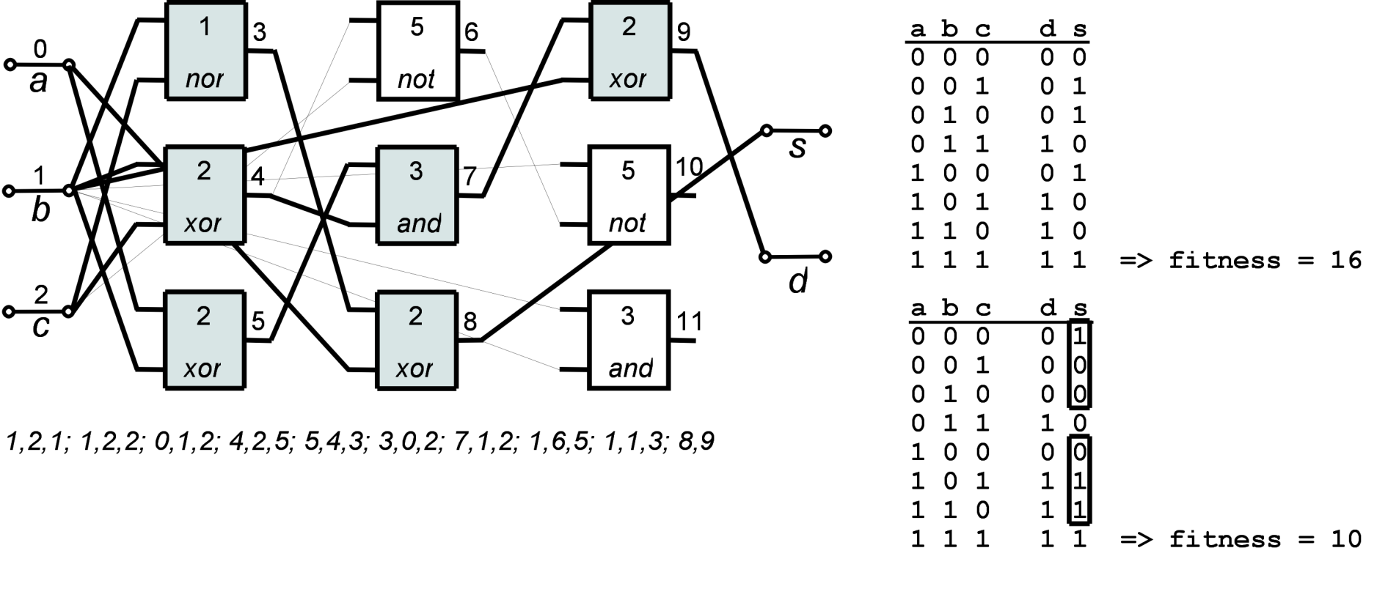
CGP: Representation for logic networks (example)
CGP parameters
n_{r}=3 (#rows)
n_{c} = 3 (#columns)
n_{i} = 3 (#inputs)
n_{o} = 2 (#outputs)
n_{a} = 2 (max. arity)
L = 3 (level-back parameter)
Γ= {NAND⁽⁰⁾, NOR⁽¹⁾, XOR⁽²⁾, AND⁽³⁾, OR⁽⁴⁾, NOT ⁽⁵⁾}
Genotype (netlist):
n_{a}+1 integers per node; n_{o} integers for outputs;
Constant size: n_{c}n_{r}(n_{a} + 1) + n_{o} integers
Phenotype (directed acyclic graph ⇒ circuit):
Variable size; unused nodes are ignored.

Slide 53
CGP: Circuit construction from a chromosome
From the outputs to the inputs:
Example. n_{c} = 3, n_{r} = 3, n_{i} = 3, n_{o} = 2, n_{a} = 2, L = 3, F = {NAND (0), NOR (1), XOR (2), AND (3), OR (4), NOT (5)}
Chromosome: (1,2,1) (1,2,2) (0,1,2) (4,2,5) (5,4,3) (4,0,2) (7,1,2) (1,6,5) (1,1,3) (8,9)
4
5
7
8
9
8
9
3
6
9
0
1
4
7
10
2
5
8
11

Slide 54
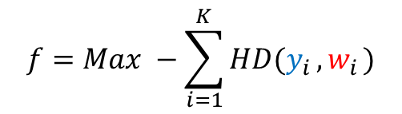
CGP: Fitness function for circuit design
Specification
(1-bit adder),
target table:
Typical fitness function (to be maximized):
$$f=Max −\sum_{i=1}^{K}{HD(y_{i}}{,w}_{i})$$
The number of test vectors
Additional objectives:
area (the number of gates)
delay
power consumption etc.
Hamming distance (between circuit response and desired response)
Max = #outputs * 2^{#inputs} (in our case 2 * 2⁸ = 16)
K = 2^{#inputs} for combinational circuits. Not scalable!!!

Slide 55
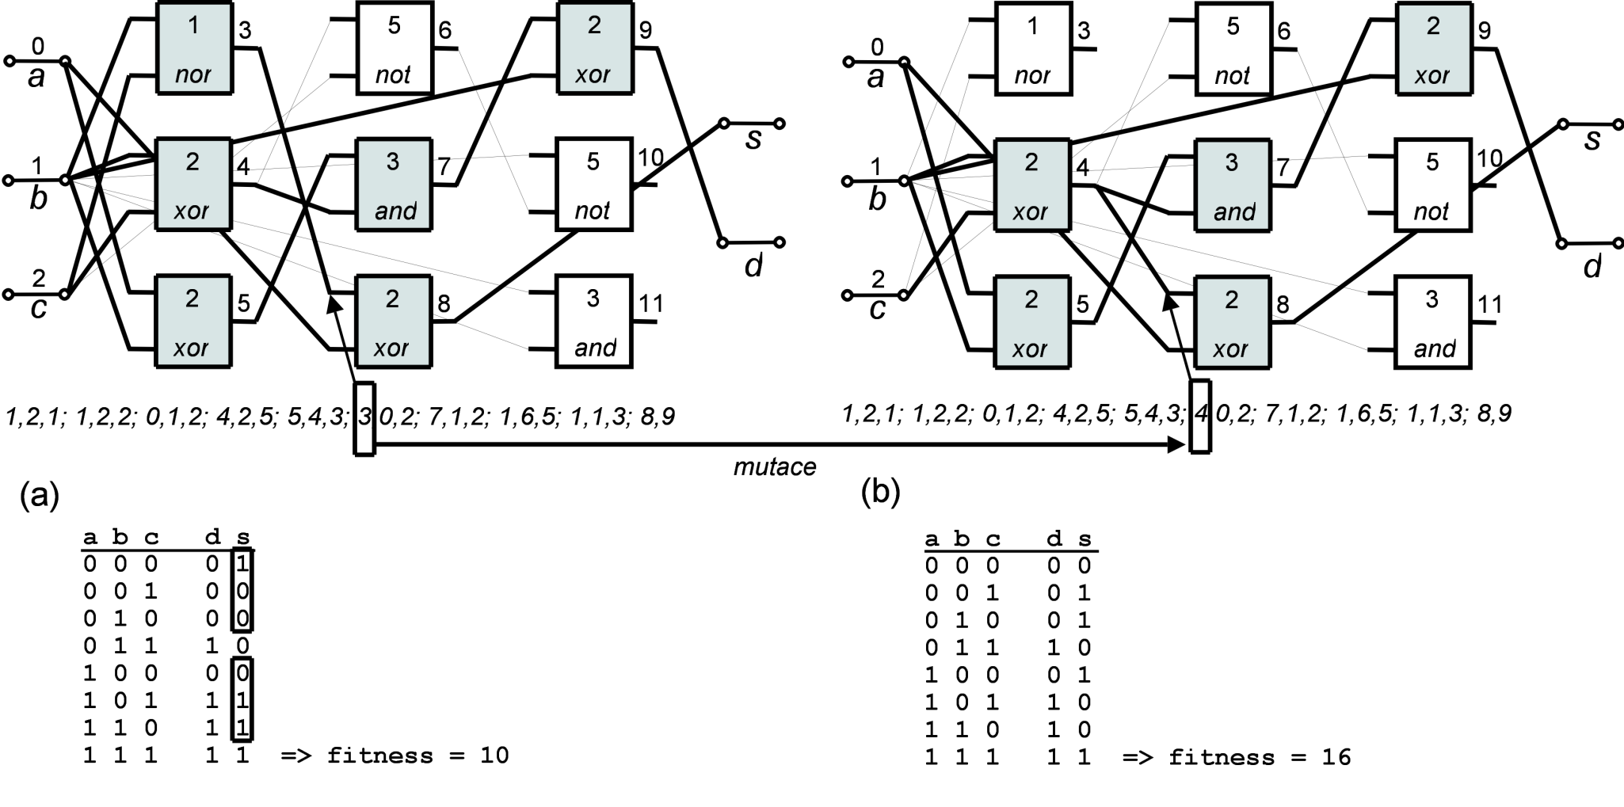
CGP: Mutation-based search
Mutation: Randomly select h integers and replace them by randomly generated (but legal) values.
Mutation can be useful, harmful or neutral.
mutation
(for full adder)
More on mutations in CGP -> Goldman B.W., Punch W.F.: Analysis of Cartesian Genetic Programming's Evolutionary Mechanisms. IEEE Trans. Evolutionary Computation 19(3): 359-373 (2015)

Slide 56
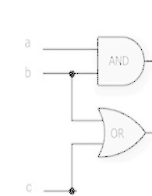
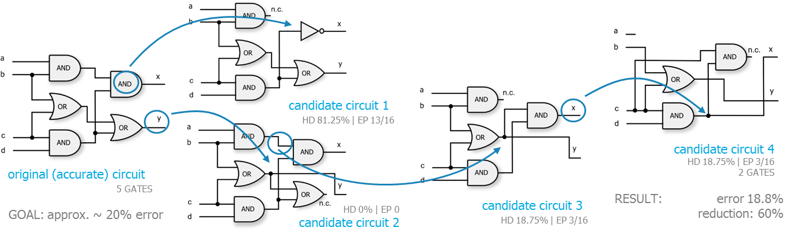
CGP: Search algorithm (1 + λ)

Slide 57
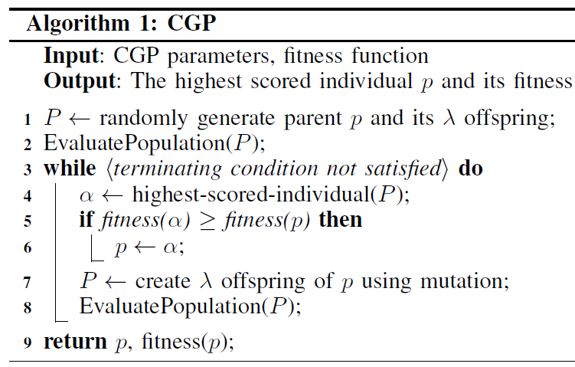
CGP: Search algorithm (1 + λ)
; // or use conventional designs
≥ is better than > as it increases the diversity of the population and leads to better solutions.

Slide 58
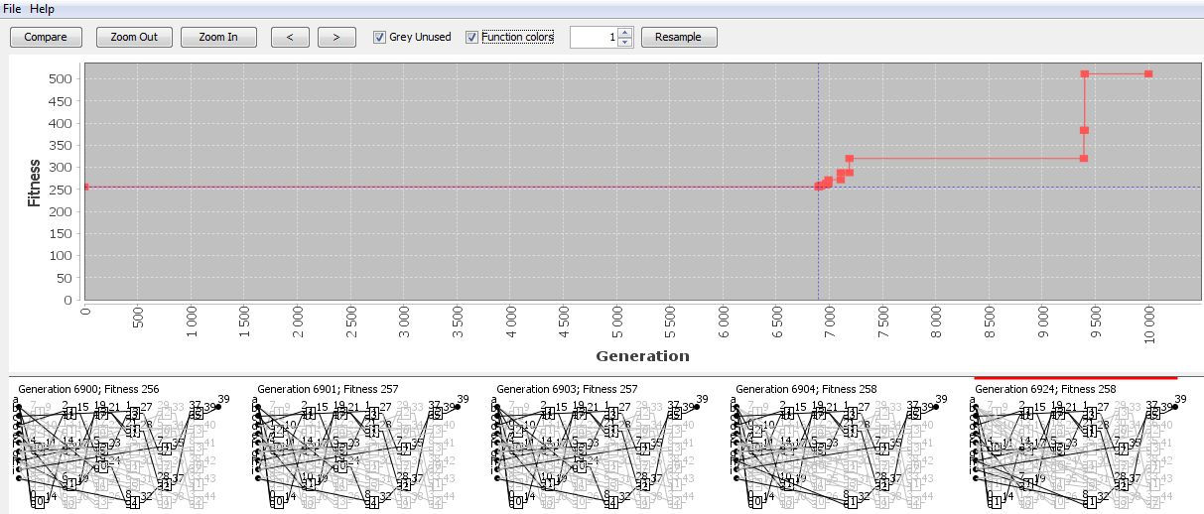
CGP: Example 9-parity
9-bit even parity circuit
n_{i}=9, n_o=1, n_{c}=6, n_{r}=6, l=1, n_{a}=2, Γ= {and, or, xor, identity}, λ = 4, and 10,000 generations; randomly generated initial population
f_{max}=2⁹=512.
the best fitness was improved

Slide 59
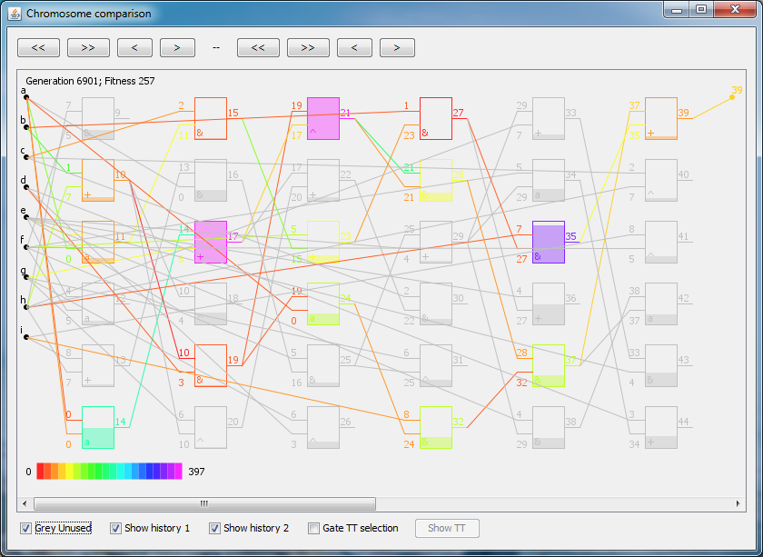
CGP: Example 9-parity (analysis of a candidate solution with fitness 257)
Unused gates:
Grey color
The age of components shown by:
color
degree of filling of the box
The best phenotype in generation 6901 with the fitness value 257

Slide 60
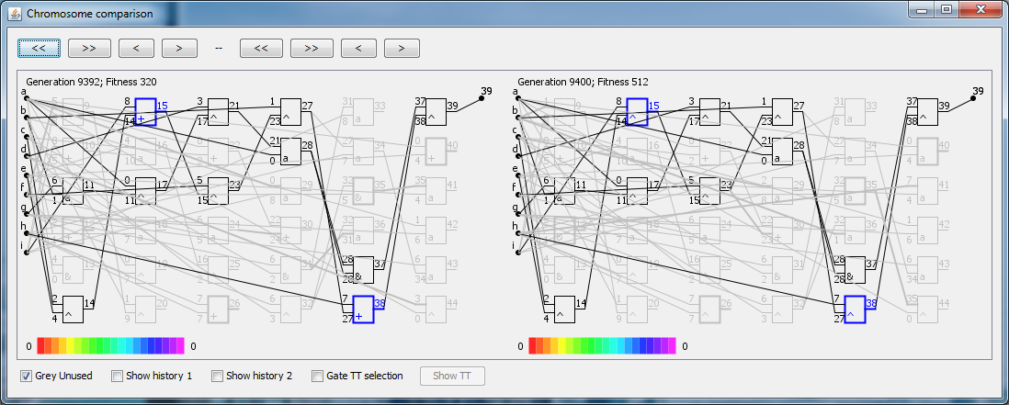
CGP: Example 9-parity
Generation: 9392
Fitness: 320
Generation: 9400
Fitness: 512 (a solution discovered!)

Slide 61
Outline
Introduction
Evolutionary algorithms
Genetic programming
Cartesian genetic programming
Applications from FIT
Summary

Slide 62
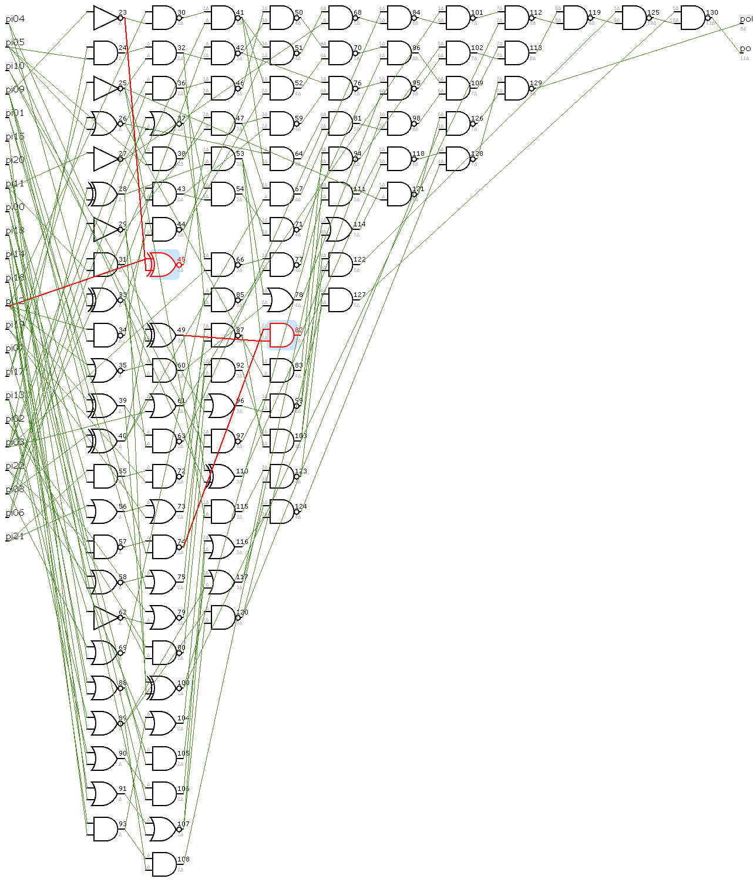
CGP: Minimization of the number of gates of a fully-functional circuit
Circuit: Cordic (LGSynth93)
23 inputs, 2 outputs
Original: 106 gates
After optimization: 39 gates
(the best circuits discovered during a CGP run are shown)

Slide 63




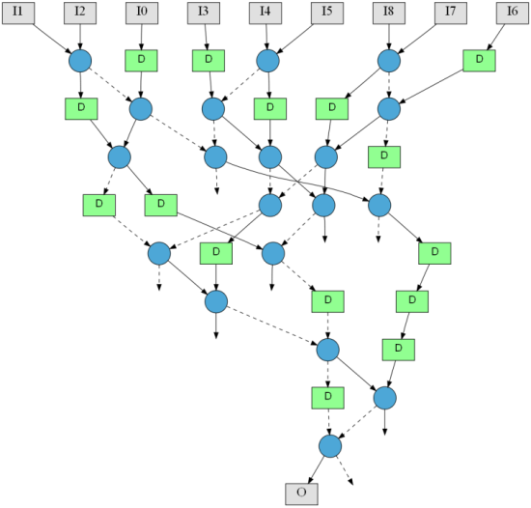

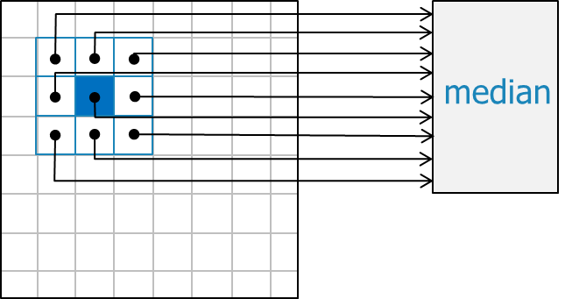
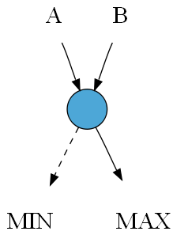
Non-linear image filter
corrupted image (10% pixels, impulse noise)
filtered image (9-input median filter)
original

Slide 64
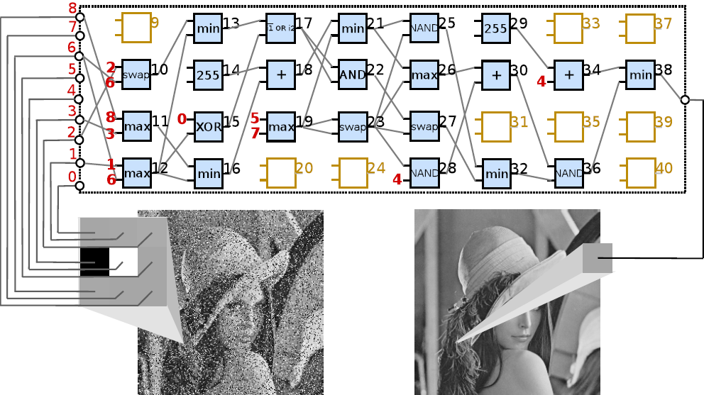

Evolutionary design of image filters with CGP
Compare
fitness
Input image
Output image - v
Golden image - w
N x M pixels
n_{i}=9, n_o=1, n_{c}=8, n_{r}=4, n_{a}=2, λ = 7; 30,000 generations/run; mutation: max. 5%
Function set (over 8 bits) = {+, min, max, swap, constants, average, log. functions}
64

Slide 65

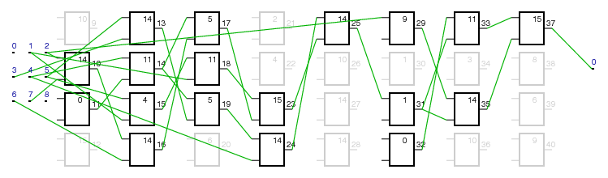



CGP: Evolutionary design with 8-bit components (FPGA)
Image corrupted by 5% salt-and-pepper noise PSNR: 18.43 dB (peak signal to noise ratio)
Original image
Median filter (kernel 3x3) PSNR: 27.92 dB 268 FPGA slices; 305 MHz
Evolved filter (kernel 3x3) PSNR: 37.50 dB 200 FPGA slices; 308 MHz
a)
FPGA: Virtex II Pro
d)
c)
b)

Slide 66

Comparison of various filters
Mean PSNR for 25 test images (salt-and-pepper noise)
MF – Median Filter; AMF – Adaptive Median Filter
The single filter and 3-bank are evolved filters (Sekanina, Vašíček: Czech patent #304181).
Best SW - Y. Dong, S. Xu: A new directional weighted median filter for removal of random-valued impulse noise. Signal Processing Letters. vol. 14, no. 3, p. 193–196, 2007

Slide 67






Hash function design
32
IPv4 flow ID
32
Hash function (h)
16
32
Fitness (the weighted number of collisions for 20k training vectors)
$$f\left(h\right)=\sum_{i=i}^{s}{g_{i}}, where$$
$$g_{i}=\left\{\begin{aligned}0 \\ \\ \sum_{j=2}^{K_{i}}{j^{2}}\end{aligned}\begin{aligned} if K_{i}≤1 \\ \\ \\ if K_{i}≥2\end{aligned}\right.$$
$s$ – the number of memory slots
$K_{i}$ – the number of inputs mapped to i-th slot
Task: IPv4 network flow hashing, input: 3 x 32 bit, output: 16 bit hash
Objective: minimize the number of collisions and the time of hashing
1 x 20 nodes, Function set (over 32 bits): $Γ=\{RightRotation, XOR,+,∗\}$
67
Grochol D., Sekanina L. AHS 2018

Slide 68



CNN design with CGP
phenotype
genotype
Suganuma M. et al. GECCO 2017

Slide 69
Summary: EA
EA is a population-based stochastic search algorithm.
EAs are typically used as black box optimizers for highly non-linear, multi-modal and deceptive objective functions with many constraints.
You should understand EA’s
advantages:
wide applicability
no prior assumptions about the problem
multi-objective optimization/design supported
a naturally parallel implementation
disadvantages:
non-deterministic; EAs do not guarantee finding an optimal solution
higher execution time, especially for complex problems
a lot of parameter tuning for each new application
only limited theory available

Slide 70
Summary: GP
Genetic programming enables the automated design of computer programs (or other “executable” structures) without requiring the user to know or specify the form or structure of the solution in advance.
Human competitive designs were discovered with GP in many application domains.
GP can optimize programs/circuits … with respect to many objectives (the quality, program size, energy requirements etc.)
A solution produced by GP is usually more understandable than NN.

Slide 71




References
Riccardo Poli, William B Langdon, Nicholas Freitag McPhee: A Field Guide to Genetic Programming, Lulu.com 2008, http://www.lulu.com/content/2167025
Koza J. et al.: Genetic Programming IV: Routine Human-Competitive Machine Intelligence, Springer, 2005
Koza J.R. Introduction to Genetic programming (tutorial), GECCO 2004
http://www.genetic-programming.com/johnkoza.html#anchor6005241
The Genetic Programming Bibliography at http://gpbib.cs.ucl.ac.uk/
Eiben A. E., Smith J.E.: Introduction to Evolutionary Computing, Springer, 2007
https://www.cs.vu.nl/~gusz/ecbook/ecbook.html
Miller J.F. Cartesian Genetic Programming, Springer, 2011
https://www.cartesiangp.com/
Sekanina L., Vašíček Z., Mrázek V.: Automated Search-Based Functional Approximation for Digital Circuits. Approximate Circuits - Methodologies and CAD. Springer, 2019, pp. 175-203
DEAP: Distributed Evolutionary Algorithms in Python
https://deap.readthedocs.io/en/master/

Slide 72
Thank you for your attention!
Lukáš Sekanina
Faculty of Information Technology
Brno University of Technology
sekanina@fit.vutbr.cz
https://www.fit.vut.cz/person/sekanina/
BISSIT, July 15, 2021

